Slide 1

Health buddy
Avneet Kaur Dhingra
Brahmjot Singh
Harshita
Shubh Goel

Slide 2
01
INTRODUCTION
OBJECTIVE
02
DOMAIN
RESEARCH
03
technology
used
04
BUSINESS MODEL
05
SWOT ANALYSIS
06

Slide 3
INTRODUCTION
Diabetes is a chronic condition that requires consistent management and monitoring to prevent serious complications. One of the essential components of diabetes management is insulin administration, which is often a daunting task for patients. Patients need to take insulin injections at the right time, along with timely meals to avoid any adverse effects. In this regard, we have developed an app specifically designed for diabetes patients to help manage their insulin injections and medication.

Slide 4
OBJECTIVE
Many diabetes patients face challenges in adhering to their insulin administration schedule and ordering medicines in a timely manner. These challenges can result in missed doses and delayed medication refills. Existing solutions, such as manual reminders or paper-based systems, may not be sufficient to address these challenges.
This project aims to develop a solution to overcome this problem.

Slide 5
Domain research
01
02
Understanding diabetes and its management
Identifying the challenges faced by diabetes patients
Researching technology solutions
Evaluating user experience
Ensuring regulatory compliance
03
04

Slide 6
Technologies used
python
pandas
figma
plyer
GUI

Slide 7
Business model
Subscription Model: a subscription-based model would generate a recurring revenue stream for the business.
Freemium Model: in a freemium model the app is free to download and use, but patients can pay for premium features and services.
Partnership with Healthcare Providers: The app could also partner with healthcare providers to offer the app as part of their diabetes management program.
Selling Patient Data: This would require obtaining patient consent and complying with relevant privacy laws. It will help the medical organizations to track the record of a particular patient.

Slide 8




Swot analysis
1. Provides a convenient and accessible solution for diabetes management.
2. Offers a wide range of features to help patients manage their condition effectively.
1. Dependence on accurate patient data and adherence to regulatory requirements.
2. Initial investment costs for app development and maintenance.
1. Growing market demand for diabetes management solutions.
2. Opportunity to expand into other chronic disease management markets
1. Disruptive technologies that could render the app obsolete
2. Economic factors that could impact demand for diabetes management solutions

Slide 9
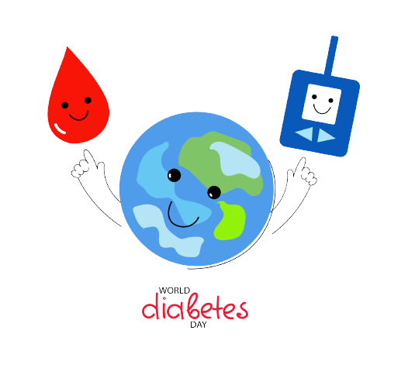
Thank
you

